Slide 1


E-Commerce For Goodwill
Pratik Kumar Gaigawale
Parinaya Joshi
Ashwani Kumar
Under the Guidance of Dr. Wook-Sung Yoo

Slide 2
CONTENTS
Introduction to Multi channel E-Commerce
Problem Statement
Technology used
Project Demonstration
Conclusion and Recommendation for Future

Slide 3

Introduction
Objective:
“To create a web application that enables Goodwill industries to list their products on multiple channels like eBay, Facebook and Amazon. Also make sure that the products once sold get unlisted from all the channels.”

Slide 4
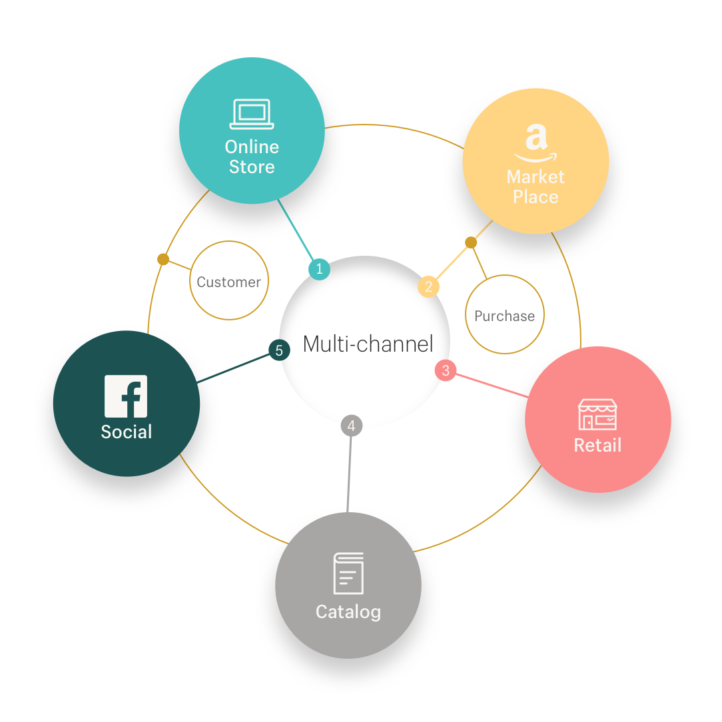
What is Multichannel listing?

Slide 5

Problem Statement
“To provide an upgrade to Goodwill industries E-Commerce website which is currently unable to list their products on multiple channels.”

Slide 6

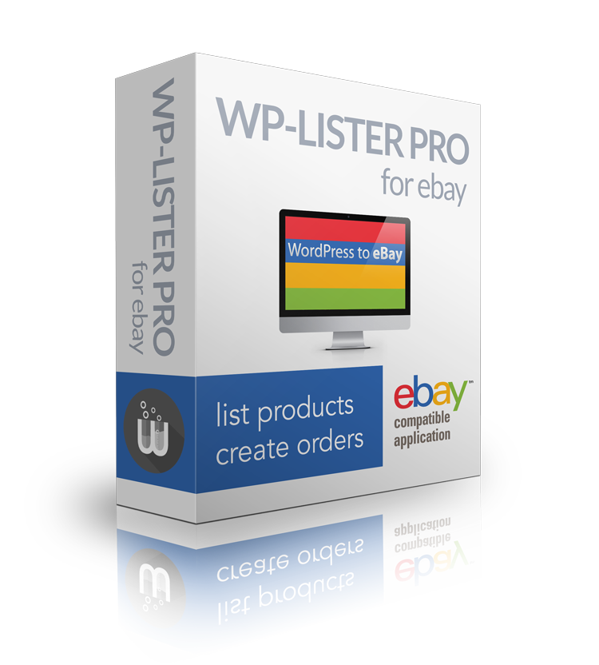
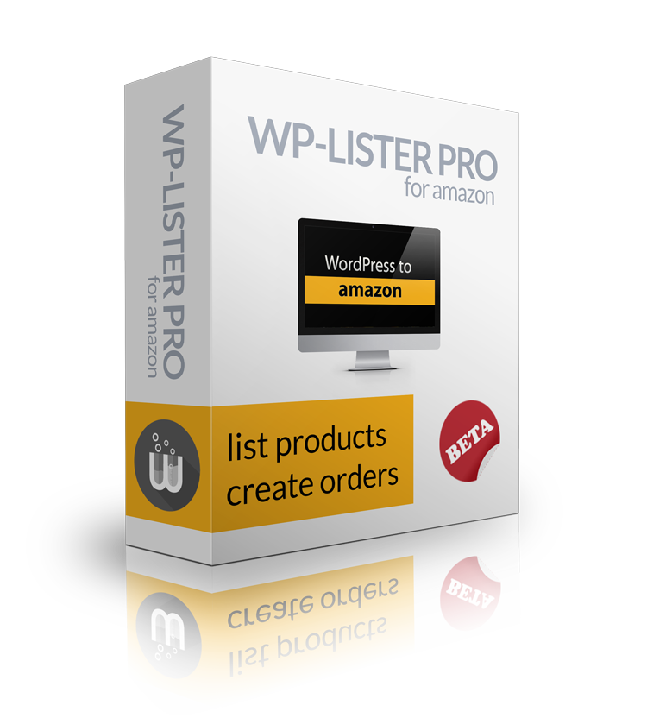

Methodology
Technology used:
1. WordPress
Plugins used:
WP lister for eBay
WP lister for Amazon
Facebook for WooCommerce

Slide 7

Project Demonstration
www.goodwillhunting.org/marketplace/wp-admin

Slide 8

Conclusion and Recommendation for the future
With the help of WooCommerce and WP plugins, we listed items from local store to multiple marketplaces like eBay, Amazon and Facebook store.
Also We have made a provision for Walmart and Etsy so in future we can configure it to list items on Walmart and Etsy marketplace. We can add other marketplaces by creating our own plugins for different marketplaces with their API’s.

Slide 9
Thank You! Questions Please!

